Slide 1
Distributed Process Management:
Distributed Global States and
Distributed Mutual Exclusion

Slide 2
Distributed systems limitations
Absence of a global clock
  Possible solutions
    Common clock for all distributed computers
      Disadvantage: Unpredictable and variable transmission delays make it impractical
    Synchronized clocks, one for each computer
      Disadvantage: Each clock will drift at a different rate, making it impractical
  Conclusion
    No system-wide physical common (global) clock can be implemented
  Consequences
    Temporal ordering of events is difficult (e.g., scheduling)
    Collecting up to date information is difficult
Absence of shared memory
  No single process can have complete, up-to-date state of entire distributed system (global state)

Slide 3
Distributed systems limitations (cont.)
Any operating system or process cannot know accurately the current state of all processes in the distributed system
An operating system or process can only know
  The current state of all processes on the local system
  The state of remote operating systems and processes that is received by messages
    These messages represent the state in the past
Implementation of mutual exclusion and avoidance of deadlock and starvation become much more complicated

Slide 4
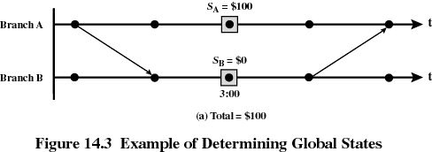
Example
Bank account distributed over two branches
  The total amount in the account is the sum at each branch
  Account balance determined at 3 p.m.
  Messages are sent to request the information
Process/event graph: processes, events, snapshots, and messages

Slide 5
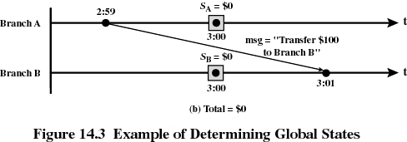
Example (cont.)
At the time of balance determination, the balance from branch A is in transit to branch B
Balance = $0

Slide 6
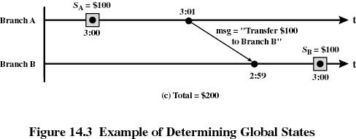
Example (cont.)
Possible solution: include in the ‘state’ information both the current balance and the transfers (messages)
Additional problem: the clocks at the two branches are not perfectly synchronized
Balance: $200

Slide 7
Terminology
Channel
  Exists between two processes if they exchange messages
  Each channel is unidirectional
State
  Sequence of messages that have been sent and received along channels incident with the process
Snapshot
  Records the state of a process
  Includes a record of all messages sent and received on all channels since the last snapshot
Global state
  The combined state of all processes
Distributed Snapshot
  A collection of snapshots, one for each process

Slide 8
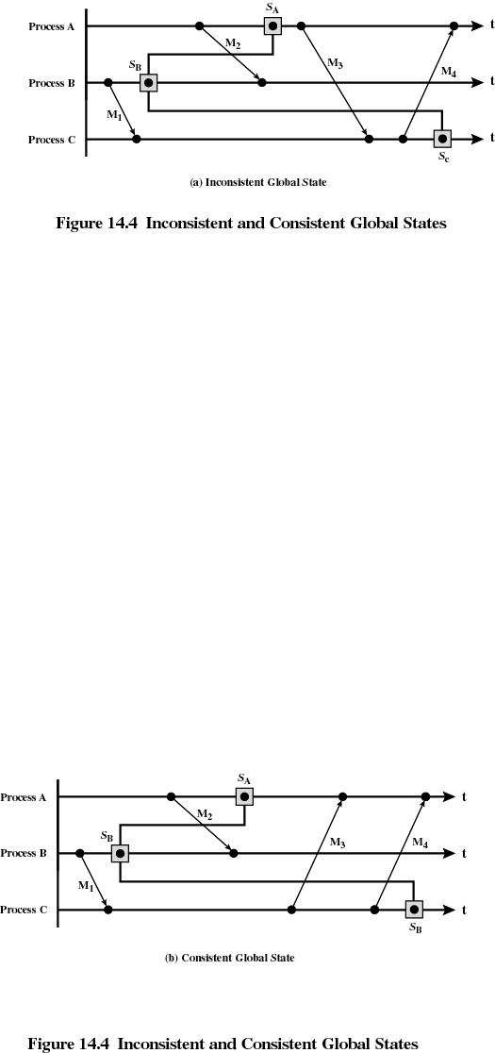
Global State

Slide 9
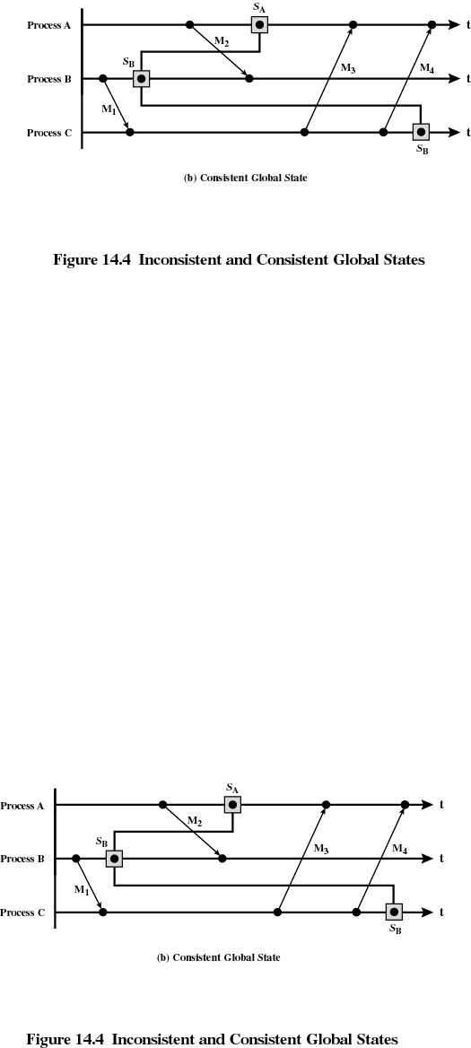
Global State

Slide 10
Distributed Snapshot Algorithm
Algorithm that records a consistent global state
Assumptions
  Messages are delivered in the order that they are sent
  No messages are lost
Principle of operation
  Algorithm based on the use of a special control message, a marker
  A process q initiates the algorithm by recording its state and sending a marker on all outgoing channels
  Every other process p, upon receipt of the marker
    Records its local state Sp
    Records the state of the incoming channel from q to p as empty
    Propagates the marker to all its neighbors along all outgoing channels
  After recording its state, if p receives a marker from another process r
    Process p records the state of the channel from r to p as the sequence of messages p has received from r from the time p recorded its local state Sp to the time it received the marker from r
  Algorithm terminates at a process after the marker has been received at every incoming channel

Slide 11
Distributed Snapshot Algorithm (cont.)
Observations
  Any process can start the algorithm and send the marker
  The algorithm will complete in finite time if all messages are delivered in finite time
  Each process is responsible for recording its own state and the state of its incoming channels
  After recording all states, the consistent global state obtained by the algorithm can be exchanged by all processes by having each process
    Send the state data recorded along every outgoing channel
    Send the state data received along every incoming channel

Slide 12
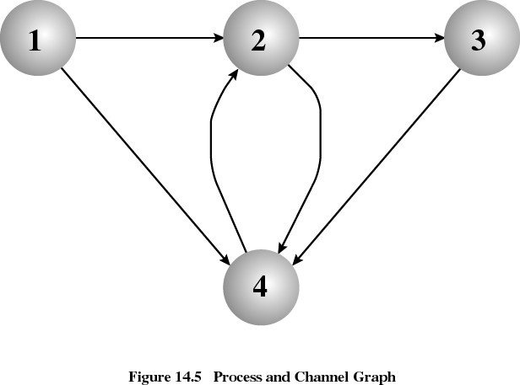
Distributed Snapshot Algorithm - Example
There are four processes, 1, 2, 3, and 4
The snapshot algorithm is run with nine messages sent along each of the outgoing channels of each process
Process 1 starts recording the global state after sending six messages
Process 4 starts recording the global state after sending three messages
On termination, snapshots are collected from each process

Slide 13
Distributed Snapshot Algorithm – Example (cont.)
Process 1
Outgoing channels
  2 sent 1, 2, 3, 4, 5, 6
  3 sent 1, 2, 3, 4, 5, 6
Incoming channels
Process 3
Outgoing channels
  2 sent 1, 2, 3, 4, 5, 6, 7, 8
Incoming channels
  1 received 1, 2, 3, stored 4, 5, 6
  2 received 1, 2, 3 stored 4
  4 received 1, 2, 3
Process 2
Outgoing channels
  3 sent 1, 2, 3, 4
  4 sent 1, 2, 3, 4
Incoming channels
  2 received 1, 2, 3, 4 stored 5, 6
  3 received 1, 2, 3, 4, 5, 6, 7, 8
Process 4
Outgoing channels
  3 sent 1, 2, 3
Incoming channels
  2 received 1, 2 stored 3, 4

Slide 14
Ordering of events in a distributed system: Lamport’s method
Lamport’s time-stamping method
  Events are ordered in a distributed system without the need for physical clocks
  Time-stamping method orders events consisting of transmission of messages
  An event is defined every time a process sends a message: the event corresponds to the time the message leaves the process
  Each system i in the network
      Maintains a local counter, Ci, which represents the clock for that system
      When the system transmits a message, it first increments its clock by 1
      The message sent has the format
  (m, Ti, i)
      where
      m = contents of the message
      Ti = timestamp for this message, set to Ci
      i = identifier for this site

Slide 15
Ordering of events in a distributed system: Lamport’s method (cont.)
Lamport’s time-stamping method (cont.)
  When the message is received, the receiving system j sets its clock to one more than the maximum of its current value and the incoming time-stamp
  Cj 1 + max [ Cj, Ti ]
  Ordering of events at every site is determined by the following rule: Message x from site i proceeds message y from site j if
    Ti < Tj, or
    Ti = Tj and i < j
  The time associated with each message is the time-stamp of the message

Slide 16
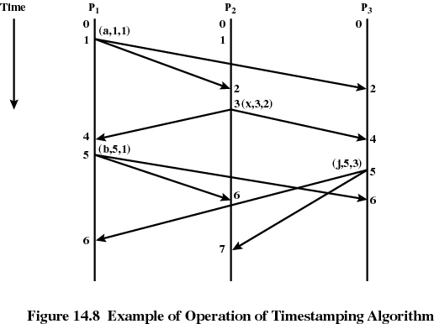
Ordering of events in a distributed system: Lamport’s method: Example 1
There are three sites, each with a process controlling the time-stamping algorithm
P1 sends message (a, 1, 1)
  P2 and P3 receive message and increment local clocks
P2 sends message (x, 2, 3)
  P1 and P3 receive message and increment local clocks
P1 sends message (b, 5, 1) and P3 sends (j, 5, 3) at about the same time
  P1, P2, and P3 receive messages and adjust local clocks
The ordering of messages at all sites is the same:
[a, x, b, j]

Slide 17
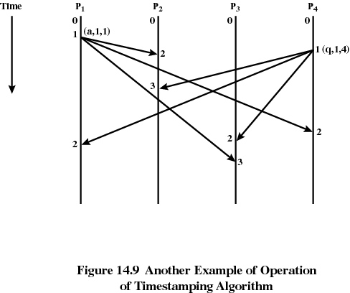
Ordering of events in a distributed system: Lamport’s method: Example 2
There are four sites, each with a process controlling the time-stamping algorithm
P1 and P4 send messages with the same time-stamp
  At site 2, the message from P1 arrives before the one from P4
  At site 3, the message from P4 arrives before the one from P1
The ordering of messages at all sites is the same
[a, q]

Slide 18
Ordering of events in a distributed system: Lamport’s method: (cont.)
Observations
  Ordering obtained with this method does not necessarily correspond to the actual time sequence
  However, all processes involved agree on the ordering imposed on these events
  The local clocks can be incremented for local events also, but the method does not distinguish between those events and the sending of messages
  The method can be used for sequencing events from different processes only if processes exchange messages
  In the implementation of solutions for mutual exclusion and deadlock detection processes do send messages to each other, therefore this method is applicable

Slide 19
Ordering of events in a distributed system: Vector clocks [SiS]
Each process Pi has a clock Ci, which is an integer vector of size ‘n’ (n = number of processes)
For every event ‘a’ in Pi, the clock has a value Ci(a), called the time-stamp of event ‘a’ in Pi
The elements of clock Ci(a) are the clock values of all processes, e.g.
  Ci [ i ], the i-th entry, is Pi clock value at ‘a’
  Ci [ j ], for j ≠ i is Pi’s best guess of Pj’s logical time (last event in Pj communicated to Pi)
Implementation rules
  Ci incremented for every event ‘a’ in Pi
  Ci [ i ] ← Ci [ i ] + d, where d > 0
  If event ‘a’ is Pi sending message ‘m’, then message ‘m’ receives vector time-stamp
  tm = Ci (a)
  When Pj receives message ‘m’, its clock Cj updated
  ∀ k, Cj [ k ] ← max (Cj [ k], tm [ k ] )

Slide 20
Ordering of events in a distributed system: Vector clocks (cont.)
Example
(1, 0, 0) (2, 0, 0) (3, 4, 1)
P1
e11 e12 e13
(0, 1, 0) (2, 2, 0) (2, 3, 1) (2, 4, 1)
P2
e21 e22 e23 e24
(0, 0, 1) (0, 0, 2)
P3
e31 e32

Slide 21
Causal ordering (preservation of sequence order) for messages [SiS]
Objective: Preserve the sequence of sending messages by the receiving process
  If Send (M1) →Send (M2) in Pi
  then Receive (M1) →Receive (M2) in every Pj receiving M1 and M2
In a distributed system the sequence order of messages is not automatically guaranteed
Using vector time-stamps, protocols have been developed that
  Deliver a message to a process only if the message immediately proceeding it has been delivered
  If not, message is buffered until the previous message arrives

Slide 22
Local and global states [SiS]
Local state
  Let
    LSi denote local state of site (computer) Si
    Time(x) is time at which state ‘x’ was recorded
    Send(mij) is the send event of message ‘m’ by Si to Sj
    Rec(mij) is the receive event of ‘m’ by Sj
  A message transfer between Si and Sj can be included in their local states as follows
    Send(mij) ∈ LSi iff Time[Send(mij)] < Time(LSi)
    Rec(mij) ∈ LSj iff Time[Rec(mij)] < Time (LSj)

Slide 23
Local and global states (cont.) [SiS]
There are two sets of messages that were sent from Si to Sj (excluding messages sent and received and recorded as such)
  Transit
  Transit (LSi, LSj ) = { mij | Send(mij) ∈ LSi & Rec(mij) ∉ LSj }
  (these are messages recorded in LSi as sent, but not recorded in LSj as received)
  Inconsistent
  Inconsistent (LSi, LSj ) = { mij | Send(mij) ∉ LSi & Rec(mij) ∈ LSj }
  (these are messages recorded in LSj as received, but not recorded in LSi as sent)

Slide 24
Local and global states (cont.) [SiS]
Global state
  Global state is the collection of all local states
  GS = { LS1, LS2, . . ., LSn }
  Consistent global state
    A global state GS = {LS1, LS2, . . ., LSn } is consistent iff
    ∀i, ∀j : 1 ≤ i, j ≤ n such that Inconsistent (LSi, LSj) = Φ
    i.e., for every received message a corresponding send is recorded
  Transitless global state
    A global state is transitless iff
    ∀i, ∀j : 1 ≤ i, j ≤ n such that Transit (LSi, LSj) = Φ
    i.e., all messages sent have been received
  Strongly consistent global state
    A global state is strongly consistent if it is consistent and transitless, I.e.,
    Communication channels are empty and for all received messages the corresponding sends have been recorded

Slide 25
Local and global states: Example [SiS]
  LS11 LS12
  S1
  LS21 LS22 LS23
  S2
  LS31 LS32 LS33
  S3
  { LS12, LS23, LS33 } is a consistent GS (every Rec has a Send recorded)
  {LS11, LS22, LS32} is an inconsistent GS (S1, S2 messages Rec recorded, not Send)
  {LS11, LS21, LS31} is a strongly consistent GS

Slide 26
Mutual Exclusion Requirements
Mutual exclusion must be enforced: only one process at a time is allowed in its critical section
A process that halts in its noncritical section must do so without interfering with other processes
It must not be possible for a process requiring access to a critical section to be delayed indefinitely: no deadlock or starvation
When no process is in a critical section, any process that requests entry to its critical section must be permitted to enter without delay
No assumptions are made about relative process speeds or number of processors
A process remains inside its critical section for a finite time only

Slide 27
Mutual exclusion in distributed systems
Centralized algorithm
  One node is designated as the control node
  This node controls access to all shared objects
  To access a critical resource, a process sends Request to the local resource controlling process
  The local resource controlling process forwards Request to the control node
  The control node returns Reply (permission) when shared resource available
  When process that received resource has finished, sends Release to control node
  Disadvantages: performance and availability

Slide 28
Mutual exclusion in distributed systems (cont.)
Distributed algorithm
  All nodes have equal amount of information, on average
  Each node has only a partial picture of the total system and must make decisions based on this information
  All nodes bear equal responsibility for the final decision
  All nodes expend equal effort, on average, in effecting a final decision
  Failure of a node, in general, does not result in a total system collapse
  There exits no systemwide common clock with which to regulate the time of events

Slide 29
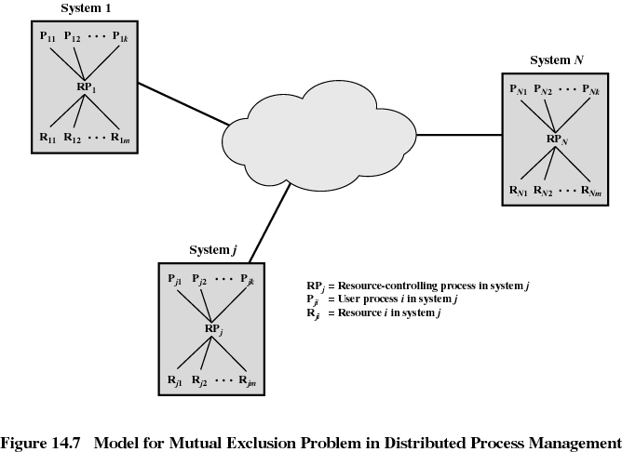

Slide 30
Mutual exclusion in distributed systems (cont.)
Mutual exclusion algorithms for distributed systems are classified by
  Their communication topology (non-token-based, token-based), and
  The amount of information maintained by each site about the other sites
  Non-token-based algorithms
    Sites exchange two or more rounds of messages
    A site can enter CS when an assertion on local variables becomes true
  Token-based algorithms
    Token is passed between sites
    A site can enter CS if it holds the token

Slide 31
Distributed queue algorithm: Lamport [SiS]
Assumptions
  Distributed system consists of N nodes, 1 to N
    Each node has a process responsible for requests to critical resources
    The process also arbitrates requests that overlap in time
  Messages are correctly received at the destination in a finite amount of time and in the order that they are sent
  The network is fully connected
  For simplicity, we assume that each site controls only one resource
Principles of operation
  All sites have a copy of the requests queue
  Time-stamping is used to assure that all sites agree on the order in which resource requests will be granted
  A process makes a decision based on its own queue, but only after it has received a message from each of the other sites to guarantee that no message earlier than the one on the head of its queue is in transit

Slide 32
Lamport’s algorithm (cont.)
Principle of operation
  Each site needs permission from all other sites
  ∀i : 1 ≤ i≤ N : : Ri = { S1, S2, . . ., SN }
  Each site Si has a Request-Queue(i) with requests ordered by time-stamps
  Between two sites, Si and Sj, messages are delivered in FIFO
Algorithm
  Request to enter critical section CS by site Si
    Si sends Request (TSi, i) message to all sites in Ri
    Si places request in its own Request-Queue(i)
    Sj receives Request (TSi, i) and places it on Request-Queue(j)
    Sj returns time-stamped Reply message to Si
  Execution of CS: Si enters CS on two conditions
    Si has received reply from all sites with time-stamp larger than (TSi, i)
    Si’s request is on top of its Request-Queue(i)

Slide 33
Lamport’s algorithm (cont.)
Algorithm (cont.)
  Release of critical section CS by site Si
    Si removes its request from top of its Request-Queue(i)
    Si sends time-stamped Release message to all other sites
    When Sj receives Release from Si, removes Si’s request from Request-Queue(j)
  When a site removes a request from its release queue, its own request may come at the top of the queue, enabling it to enter the CS
  The algorithm executes CS requests in the increasing order of time-stamps

Slide 34
Lamport’s algorithm (cont.)
Proof that the algorithm enforces mutual exclusion, is fair, avoids deadlock, and avoids starvation
  Mutual exclusion
    Requests are handled in the order imposed by time-stamping mechanism
    When Pi takes the resource, no other request could have been sent before its own
  Fair
    Requests granted in the time-stamping order
  Deadlock free
    Time-stamp ordering is maintained consistently at all sites
  Starvation free
    When Pi releases resource, it sends a Release message
    Pi’s Request messages are deleted at all sites, allowing another process to acquire resource
Performance: 3(N-1) messages are required
  (N-1) Request messages
  (N-1) Reply messages
  (N-1) Release messages

Slide 35
Ricart and Agrawala algorithm [SiS]
Principles
  Optimization of Lamport’s algorithm: Release messages merged with Reply messages
  ∀i : 1 ≤ i≤ N : : Ri = { S1, S2, . . ., SN }
Algorithm
  Request to enter critical section CS by site Si
    Si sends time-stamped Request message to all sites in Ri
    Sj receives Request and
      Sends Reply message to Si if
        Sj is neither requesting nor executing CS, or
        Sj is requesting CS, but TSj is later than TSi
      Else Sj does not send Reply
  Execution of CS: Si enters CS when
    Si has received Reply messages from all sites in Ri
  Release of critical section CS by site Si
    Si sends Reply messages

Slide 36
Ricart and Agrawala algorithm (cont.)
Performance: 2(N-1) messages
  (N-1) Request messages
  (N-1) Reply messages

Slide 37
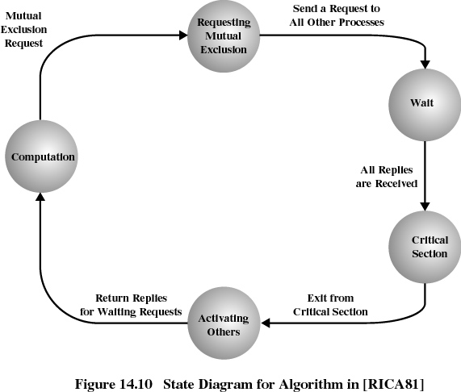

Slide 38
Token-Based Algorithms [SiS]
Principle of operation
  A site allowed to enter CS if it holds a token: unique token shared by all sites for CS access control
  Sequence numbers used by token-based algorithms (unlike non-token-based algorithms which use time-stamps)
    Upon requesting the token, a site records a sequence number
    (sequence number)i ← (sequence number)i + 1
It represents the number of requests that site made for the CS
  Sequence numbers of different sites advance independently
  Sequence numbers are used to distinguish between old (known or serviced) requests and new ones
Correctness proof
  Exclusion guaranteed if only the site that holds token accesses CS

Slide 39
Suzuki-Kasami’s broadcast algorithm
Principle of operation
  Request message
  When site Sj desires to enter CS, broadcasts a request for token message to all sites
  Sj: Request (j, n)
  where n ( n = 1, 2, . .) is a sequence number, site Sj is requesting its n-th CS execution
  When site Si receives Request message, it updates its known request numbers, an array of integers
  RNi [1, . . ., N]
  where RNi [j] is the largest sequence number received in a request message from Sj
  The update for a Request (j, n) is
  RNi[j] ← max (RNi[j], n)
  I.e., updated if new request larger than previous known, otherwise, outdated request

Slide 40
Suzuki-Kasami’s broadcast algorithm (cont.)
Principle of operation (cont.)
  Determining sites with outstanding requests and the site to receive token next
    The token contains: Q, LN [ 1, . . ,N ]
    where: Q is queue of requesting sites
    LN [ 1, . . ,N ] is array of integers, where LN [ j ] is the request that Sj executed most recently
    After executing CS, site Si
      Updates LN [ i ] ← RNi [ i ] to indicate request executed
      Identifies pending requests
      Sj: RNi [ j ] = LN [ j ] + 1
      Sj placed on Q
      Token given to first process on Q

